Slide 1

Automating audience rating prediction for online movie reviews using sentiment analysis
Avish Manish Kadakia
Student ID: 1132452
Rahul Kishorbhai Pipaliya
Student ID: 1153308
Dept. of Computer Science Lakehead University Thunderbay, Ontario

Slide 2
Introduction
The web has given its users the freedom of speech using which they can write their unbiased opinions in a blog or review.
We can examine these user reviews to predict the behaviour of consumers and also identify new opportunities in the market.
This process is called sentiment analysis and is known as opinion mining

Slide 3
What is sentiment analysis ?
Sentiment analysis, particularly the automatic analysis of written reviews in terms of positive or negative valence, has been extensively studied in the last decade. It has been widely accepted by the research community that written movie reviews seem to be rather arduous to handle. Why? One of the apparent challenges in classifying textual movie reviews is that sentiment words often relate to the elements of a movie rather than the reviewers’ opinion.
Sentiment analysis of movie reviews aims to estimate emotions of cinema audiences so that movie theatres can estimate whether to continue showing a movie or not based on audience sentiment.

Slide 4
Introduction
We have tried to implement a variety of different feature extraction techniques with different classifiers to perform sentiment analysis.
We will discuss in detail all the feature extraction methods and classification techniques in detail later.
At the end we will also compare all results, and share our thoughts on future work as well.
We have chosen the IMDB user movie review database for our problem statement as it has over 50,000 labelled user movie reviews. Each review has a rating from 1 - 4 (negative) and 7 - 10(Positive). Where (1) is the worst and, (10) is the best.

Slide 5
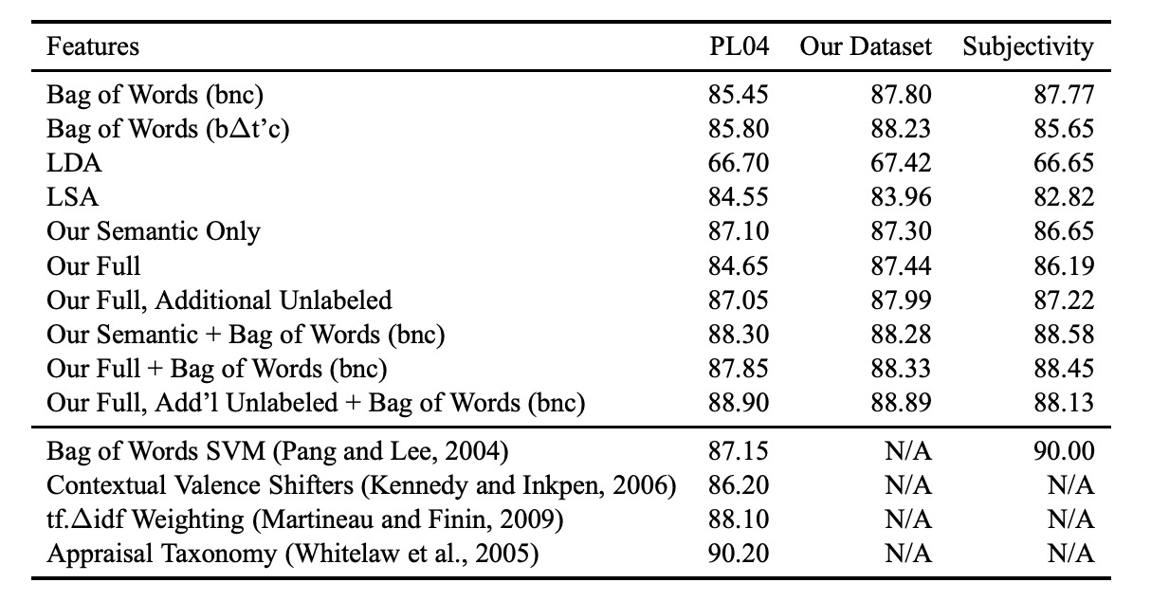
Introduction
This is the results from paper “Learning Word Vectors for Sentiment Analysis”

Slide 6
Literature Review
We have reviewed 3 papers as part of our literature review:
Learning Word Vectors for Sentiment Analysis
Sentiment Analysis of Movie Review Comments
Opinion Mining and Sentiment Analysis on Online Customer Review

Slide 7
Literature Review 1) Learning Word Vectors for Sentiment Analysis
The research presented a model which uses a mix of unsupervised and supervised techniques to learn word vectors which captures semantic term–document information as well as rich sentiment content; this helps in finding the similarity between words. To find semantic similarities among words, they derive a probabilistic model of documents which learns word representations. Their model evaluates categorization of document-level and sentence-level tasks in the domain of online movie reviews
Their model’s probabilistic foundation gives a theoretically justified algorithm for word vector induction. They extended the unsupervised model to incorporate sentiment information which showed that this extended model could leverage the abundance of sentiment labelled texts available online to yield word representations that capture both sentiments and semantic relations.

Slide 8
Literature Review 2) Sentiment Analysis of Movie Review Comments
This paper presents an empirical study of the efficacy of machine learning techniques in classifying text messages by semantic meaning.
The authors have used movie review comments from popular social network Digg as their data set and organize text by subjectivity/objectivity and negative/positive attitude.
They have proposed different approaches in extracting text features such as bag-of-words model, using huge movie reviews corpus, restricting to adjectives and adverbs, handling negations, bounding word frequencies by a threshold, and using WordNet synonyms knowledge.
For classification of movie critics, they considered three supervised – Naive Bayes, Maximum Entropy and Decision Trees, and one unsupervised classification approach – K-Means clustering. All four algorithms are available in the NLTK framework.
They measured the accuracy of automated classification for each corpus and each label using 10-fold cross-validation.

Slide 9
Literature Review 3) Opinion Mining and Sentiment Analysis on Online Customer Review
This research paper concentrates on mining reviews from websites like Amazon, which allows users to write their views. It automatically extracts the reviews from the website
It also uses algorithms such as the Naive Bayes classifier, Logistic Regression and SentiWordNet algorithm to classify the survey as a positive and negative review.
In the end, the authors have used quality metric parameters to measure the performance of each algorithm.

Slide 10
Our Approach
We have extracted features from the dataset in the form of a word vector using the feature extraction algorithm such as TF-IDF Encoding, latent semantic analysis encoding, Word2Vec embedding.
Next, we have classified the extracted dataset using the pattern recognition algorithms, namely, KNN, Support Vector Machine(SVM), and Multinomial Naive Bayes.
We have tested the algorithm with cross-validation and calculated Precision, Recall, F1-score.
We have calculated these results for these 3 conditions:
8 classes for ratings 1,2,3,4,7,8,9,10
4 classes for ratings (1-2), (3-4), (7-8), (9-10)
2 classes for ratings (1-2-3-4), (7-8-9-10)

Slide 11
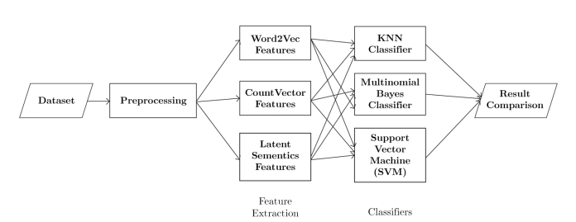
Our Approach
System Overview Diagram

Slide 12
METHODOLOGY
Importing Dataset
Data Preprocessing
Word Embeddings / Feature Extraction
Making predictions using classifiers

Slide 13
METHODOLOGY Importing Data
Training Data(No of samples 25000):
X_train,X_test
Testing Data(No of samples 25000):
y_train,y_test

Slide 14
METHODOLOGY Data Preprocessing
Removed special characters
Removed all single characters
Substituting multiple space with single space
Converting to lowercase
After cleaning our data we also performed word net lemmatization after splitting of documents so that words are converted to their proper form and we avoid creating unnecessary word vectors for the same word during the feature extraction phase.

Slide 15
METHODOLOGY FEATURE EXTRACTION / WORD EMBEDDINGS
CountVector:
First, we transformed data(X_train, y_train) using sklearn’s countVectorizer function so that each review will have a feature size of 5000. Then we passed the resulting countVectors to the tfidfTransformer to embed meaning for the frequency of each word
After this, we added padding along the axis of testing and training review vectors to match the feature size for both vectors in order to apply KNN classifier. Moving forward we convert the resulting sparse matrix into a dense matrix to optimize the classification process.

Slide 16
METHODOLOGY FEATURE EXTRACTION / WORD EMBEDDINGS
Word2Vec:
We have created a model that was trained using gensim’s word2vec model using the training review vector i.e. X_train as input.
Then we transformed the training and testing reviews using this model. As the transformation process may yield features with negative values we scaled our training and testing review vectors to have only positive values between 0-1.
Mikolov, Tomas, et al. ”Efficient estimation of word representations in vector space.” arXiv preprint arXiv:1301.3781 (2013).
Rong, Xin. ”word2vec parameter learning explained.” arXiv preprint arXiv:1411.2738 (2014).

Slide 17
METHODOLOGY FEATURE EXTRACTION / WORD EMBEDDINGS
LSA:
For LSA transformation, we first vectorized our review vectors using TfidfVectorizer. After which we project the TF-IDF vectors onto the first 100 principal components.
Next, we performed SVD on the training data and projected the results to the training review vector, and also applied the same transformation to the test review vector as well.
As performing the LSA transformation process may yield features with negative values we scaled our training and testing review vectors to have only positive values between 0-1.
Deerwester, Scott, et al. ”Indexing by latent semantic analysis.” Journal of the American society for information science 41.6 (1990): 391-407.
Landauer, Thomas K., Peter W. Foltz, and Darrell Laham. ”An introduction to latent semantic analysis.” Discourse processes 25.2-3 (1998): 259-284.

Slide 18
METHODOLOGY Making predictions using classifiers
KNN:
The main idea in KNN is to calculate the distance between each word vector during our training process.
We then compare each new word vector with these distances to obtain the K nearest neighbors and make our predictions.
The only drawback of using KNN is that it may have a very high time complexity if the dataset is too large.

Slide 19
METHODOLOGY Making predictions using classifiers
Multinomial Naïve Bayes:
In Multinomial Naive Bayes, we will calculate the probabilities of each word for a given document, using the Bayes formula.
We can then calculate the highest probability and assign that class to a new document.
We will then calculate priors Pr(c) by dividing the number of documents belonging to class c by the total number of documents and also calculate rest of the terms in formula.
The approach is quite straightforward in theory but one of the issues is that it does not take into account the similarity between words.
Kibriya, Ashraf M., et al. ”Multinomial naive bayes for text categorization revisited.” Australasian Joint Conference on Artificial Intelligence. Springer, Berlin, Heidelberg, 2004.

Slide 20
METHODOLOGY Making predictions using classifiers
SVM (SVC Classifier):
SVM is a supervised learning model that has a solid theoretical foundation and performs classification more accurately than most other algorithms in many applications.
Many researchers claim that this is the best text classifier and can be used for sentiment analysis to get great performance.
SVM linearly separates data and finds a hyperplane that fits best between 2 classes but when data is not linearly separable then we can convert data to a higher dimension and hope to find a hyperplane in a higher dimension, we can do this using kernel functions.
Moraes, Rodrigo, JoaO Francisco Valiati, and Wilson P. Gavi ˜ aO Neto. ˜ ”Document-level sentiment classification: An empirical comparison between SVM and ANN.” Expert Systems with Applications 40.2 (2013): 621-633.

Slide 21
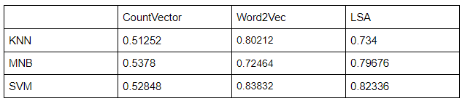
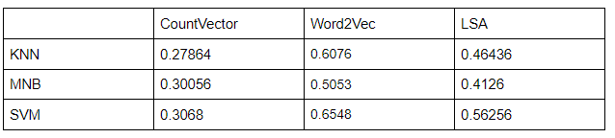
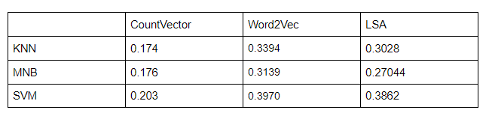
Results Testing Accuracy
2 classes for ratings (1-2-3-4), (7-8-9-10)
4 classes for ratings (1-2), (3-4), (7-8), (9-10):
8 classes for ratings 1,2,3,4,7,8,9,10:

Slide 22
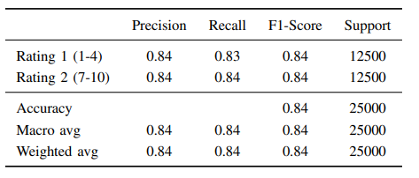
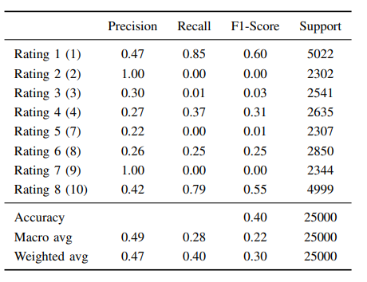
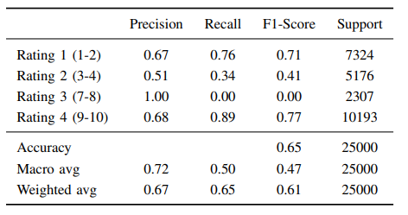
Results Testing Accuracy

Slide 23
Conclusion and Discussion
As per our experimentation results, it can be clearly observed that more than the transformation techniques and classifiers used for sentiment analysis the number of classes has a much higher impact on the accuracy especially for the dataset we have used.
There may be multiple reasons for such performance but as per our understanding, this is because even as humans are given a review with a rating of 10 and asked to classify it we may just as easily classify it as having an 8 or 9 rating.
The main reason for this being providing a rating for a review can be quite arbitrary and is heavily influenced by an individual’s opinion and cannot be predicted, as 2 people who may be given the same review may rate them differently based on their opinions.
This makes it quite hard to find a determinable pattern to rate reviews for a classifier. As a result, even the algorithms that we currently use cannot guarantee high accuracy.

Slide 24
Conclusion and Discussion
The current methods are best at approximating at a high level if a review is positive or negative rather than predicting the exact rating for the reviews.
As it is clearly evident from our results even though the same embedding techniques and classifiers were used, the accuracy we achieved for 2 classes, 4 classes, and 8 classes vary drastically.
It is also reasonable to conclude for the dataset using a combination of SVM with Word2Vec as a feature extractor provides us the best results.
Followed by SVM classifier in conjunction with LSA and KNN classifier with Word2Vec respectively. We also noticed that KNN with CountVector gave pretty bad results.

Slide 25
Future Work
As it is quite evident the biggest issue is the decrease in accuracy as the number of classes increases.
So for the future, we may want to train on an even larger dataset using machine learning models.
This is because given a large enough dataset machine learning models like ANNs, CNN, etc. may be able to learn various patterns which may help them better predict the ratings for a review.

Slide 26
Contributions
Work Done By Avish,
Research and analysis
Data preprocessing and fetching
Proof Reading of reports and other documents
Creating reusable modules for classifiers and feature extractors
Work Done By Rahul,
Research and analysis
Drafting reports and other documents
Result analysis and Accuracy improvement
Code optimization and Sanity check

Slide 27
Thank You

